Slide 1

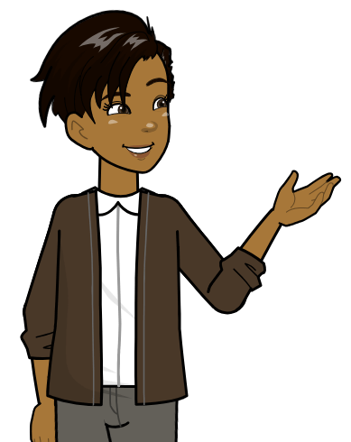



CEF’s Challenge PROGRAM
®

Slide 2
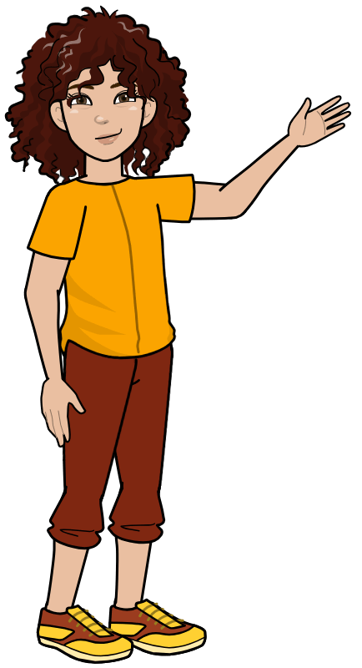

Do you like science?
Do you like to problem solve?
ASK YOURSELF
Do you like to work with others?

Slide 3


STEP ONE
STEP TWO
Pick your group
Start studying
STEP THREE
STEP SIX
WHAT NEXT?
Work through Interactive Modules
Finish and submit your video
STEP FIVE
STEP FOUR
Start planning your video
Attend the
Regional Challenge

Slide 4
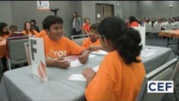
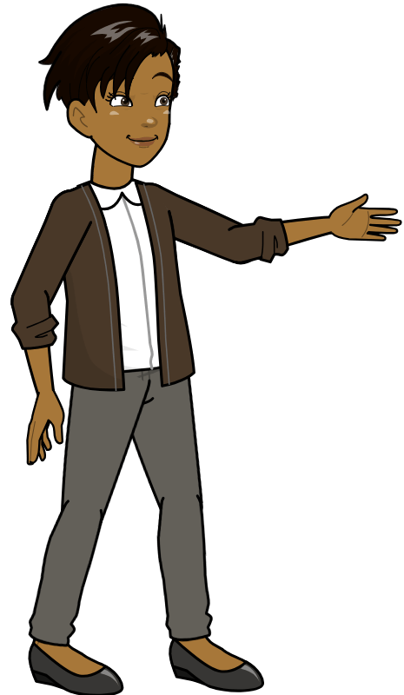
WHAT TO EXPECT

Slide 5

OCTOBER: Form Group
FALL: Study & Prepare Video
JAN-MARCH: Regional Challenge
TIMELINE
MARCH 21ST: Submit Video
MAY: State Winners Announced
JUNE 10TH 11TH: National Challenge

Slide 6
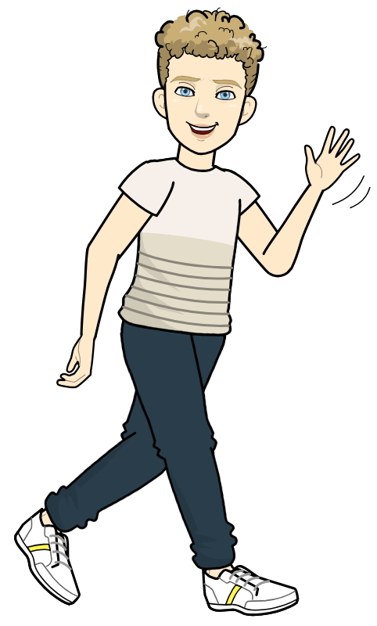


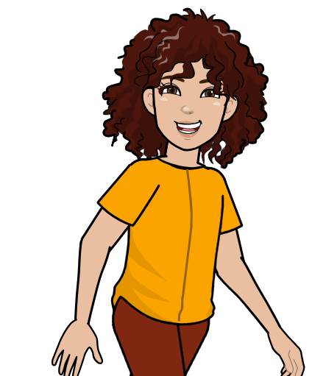

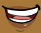
“My favorite part of the Challenge was working together as a team.”
- Challenge Participant
from Oregon
“The Challenge reinforced my goal to pursue STEM related fields!”
- Challenge Participant
from Washington
“The Challenge opened my eyes to opportunities in science careers.”
- Challenge Participant
from Illinois
“The Challenge supported my ongoing love of Science and Math.”
- Challenge Participant
from New Jersey

Slide 7

NEXT STEPS
Let your teacher know if you are interested
Go to chemed.org for more info on the Challenge

